Slide 1

Artificial Intelligence
& Data Science
Make India
an AI
Super Power
Artificial Intelligence
nodiam, Education that enlightens!
Dependable Competency Partners
Expert Industry Veterans
Lucid & Practical
IT
Competency
Scientific
Knowledge

Slide 2

AI is Not Rocket Science
Our mentors will help you:
Comprehensive teaching
Python computing skills & all relevant libraries
Data Science, AI, Analytics & Data Visualization
Computer Vision, LLM, GAN, NLP etc.
IoT & Robotics
Hands-on labs & project-based mentoring
Free internship & job experience
AI won’t replace humans. But those with AI will replace those without AI.

Slide 3

Job Opportunities in AI
AI Professionals
Data Scientists
NLP, CV, LLM, GAN Specialists
IoT Specialists & Robotics Engineers
Salary Band
Highest paid professionals in India & abroad
Fastest growing careers, globally
Highest vacancy rates in job sites

Slide 4

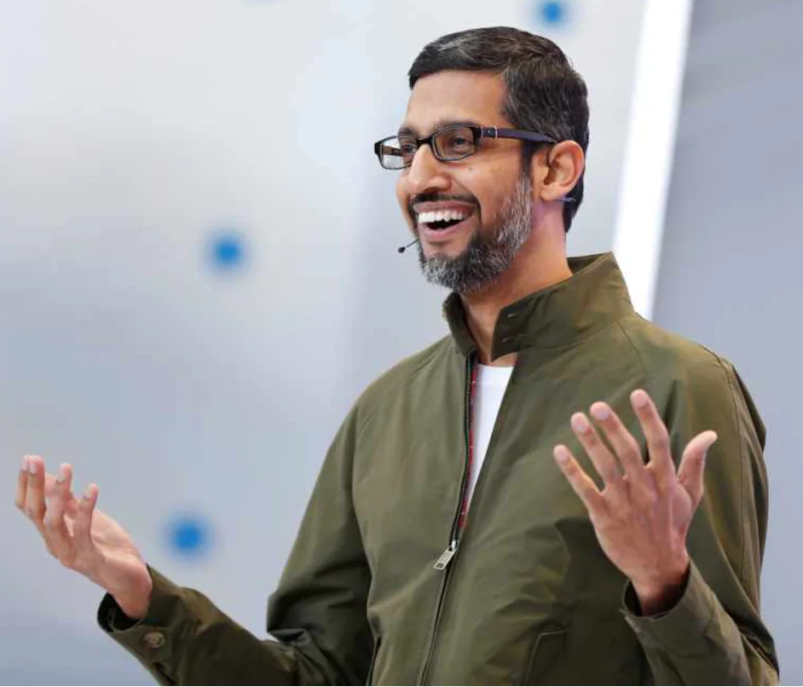
AI Supports All Aspects of Life
Civil, Mechanical, Chemical & all Engineers
Doctors, Teachers
Scientists & Researchers
Corporate Strategists, Bankers & Lawyers etc.
A.I. – more profound than fire or electricity! - Sundar Pichai, Alphabet C.E.O.

Slide 5

AI & IoT Courses Offered
Duration per course: 3 months (2 classes of 2 hours per week)
Fees per course: + G.S.T. ** Limited time offer.
₹18,000 ₹9,000 50% Off
AI for Beginners
Chat GPT & Other AI Tools
LLM & GAN Applications
Ethical Considerations
AI Project Mgmt. & Structuring
Advanced Excel
Project Work
Data Science
Python for AI
Data Analytics & Visualization
Maths for AI
Data Science Fundamentals
Project Work
Machine Learning
Neural Network
Deep Learning
Optimizing & Tuning Network
Structuring ML Projects
Project Work
NLP Engineer
NLP
GAN & LLM
Tensor Flow & Keras
Project Work

Slide 6
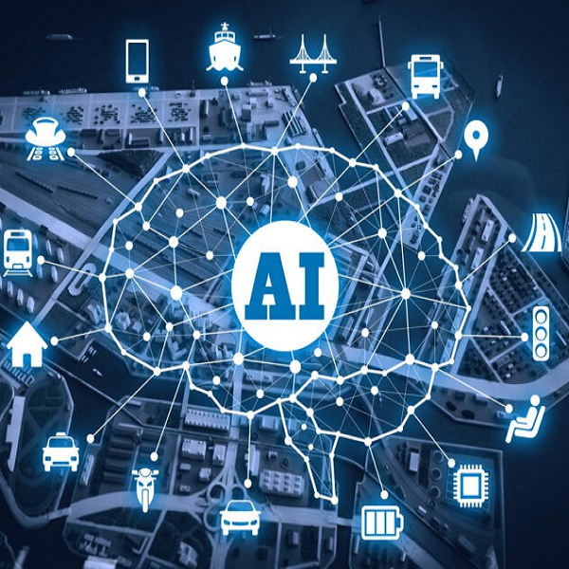
AI & IoT Courses Offered
Computer Vision
CNN
Sequence Models
Open CV
Tensor Flow & Keras
Project Work
Medical Engineering
AI for Medical Diagnosis
AI for Medical Prognosis
AI for Medical Treatment
Project Work
Audio DSP
DSP
Tensor Flow
Keras
Project Work
Senior Developer
Git Hub & Jira
Business Intelligence & DevOps
Optimizing Neural Networks
Structuring ML Projects
ML Ops & AWS AI/ML Services
Interview Prep & Project Work
IoT
Arduino, Raspberry Pi etc.
Sensor & network design
Data & knowledge management
Understanding IoT architecture
IoT security & Industry 4.0
Project Work

Slide 7
Full Stack IT Courses
Advanced Java, Spring Boot
.NET
Databases - SQL & NoSQL
Cloud Computing - AWS & GCP
PHP, WordPress
Linux, Shell Script & Networking
DevOps – Jenkins, Docker & Kubernetes
Cyber security
Automation Testing
Project Management - Agile Scrum, BA & QA
HTML, CSS, JavaScript, ReactJS, Material UI
React Native & Mobile App Dev
Duration per course:
3 months (2 classes of 2 hours per week)
Fees per course:
+ G.S.T.
** Limited time offer.
₹12,000 ₹6,000 50% Off

Slide 8
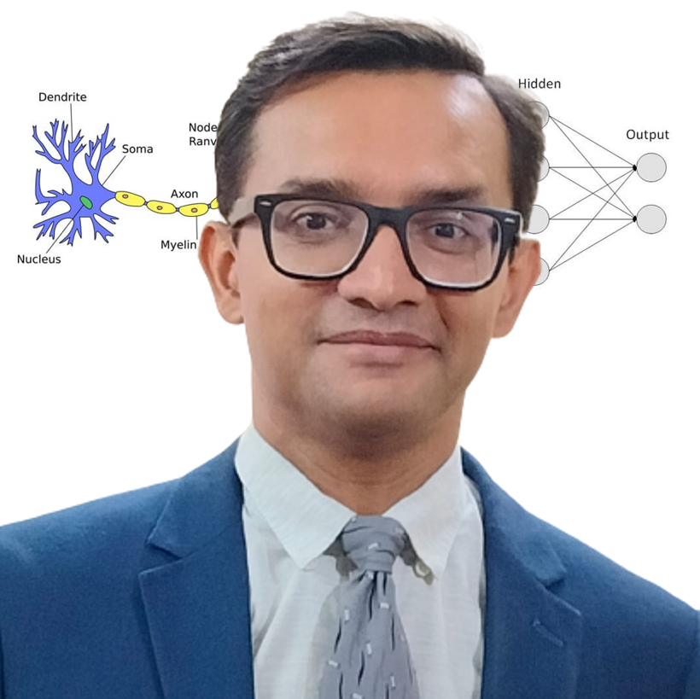
CEO & AI Department Head
Empathetic, Dynamic, & Supportive
24 years of blue-chip experience
Corporate trainer & excellent communications
Dynamo of energy, dependable & trusted for the job! – Vish Coosa, Morgan Stanley, U.S.A.
Thorough Knowledge, Can Make Difficult Concepts in AI Seem Lucid
Worked on multiple Corporate AI projects globally
Elementary thinker, visualizes subject matter through clutter & noise
Improved accuracy of AI models singlehandedly up to 99.8%
Super brain, the best guy to take care of all our AI implementation! – Government Client
Anirban Chakrabarty, C.E.O.
B.E.(Electronics), M.B.A. (Finance)
anirban@anodiam.com
+91 9073 700094 / +61 470 142 229

Slide 9
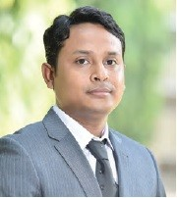
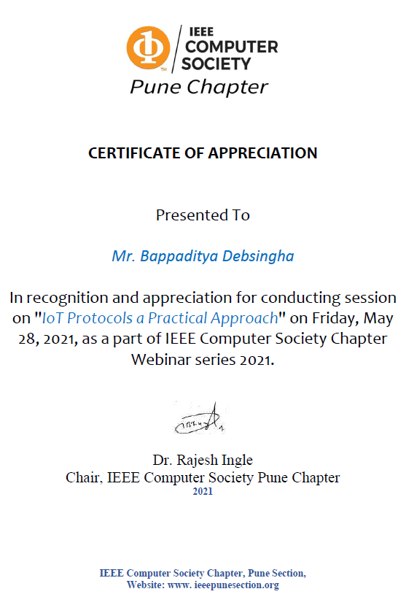
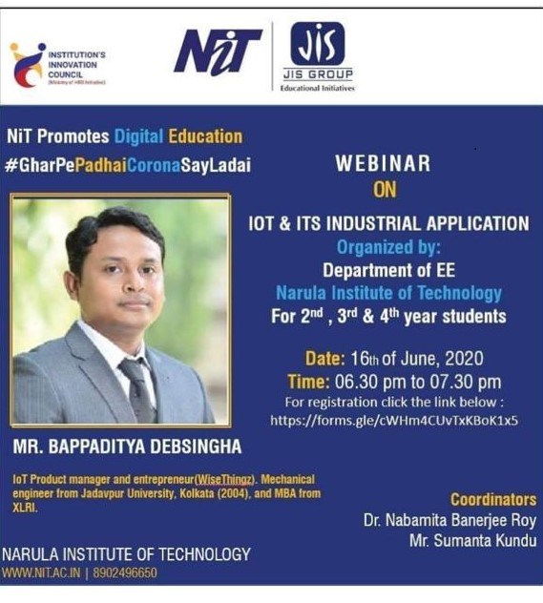
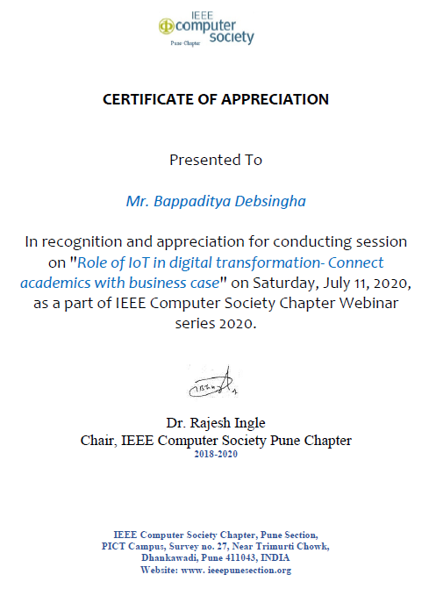
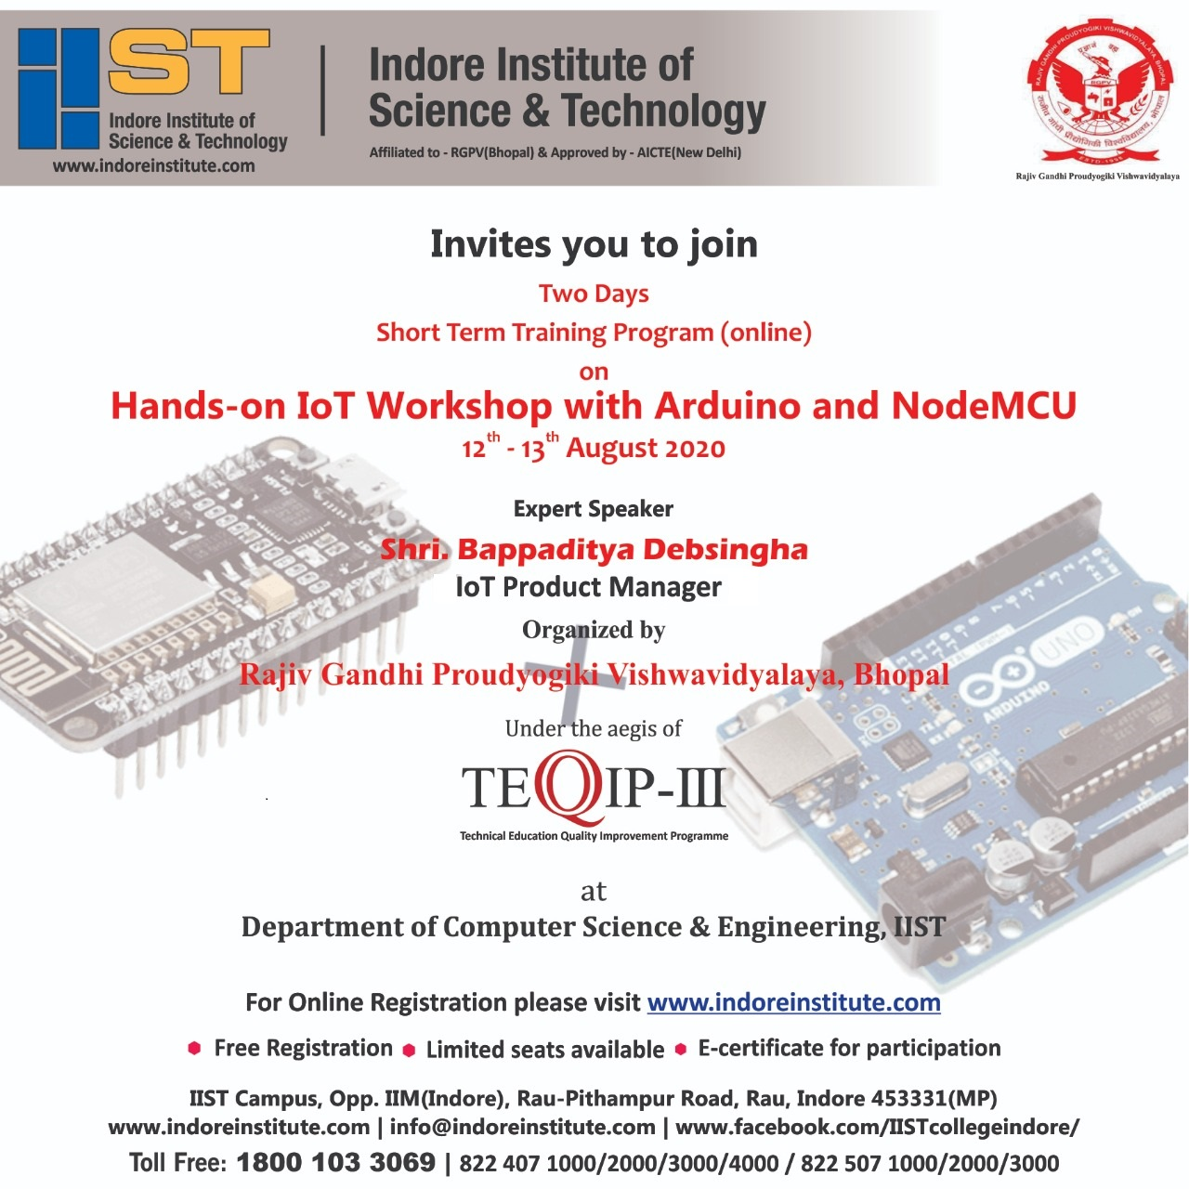
Robotics & IoT Department Head
Inspiring Mentor, Innovative & Entrepreneurial
18 years of global experience
Trained hundreds of children & industry professionals
IoT & Robotics workshops at institutions & corporates
Industry Leading S.M.E. in the fields of
Autonomous machines, automation, sensors & IoT driven BI
Analytics dashboards, Cloud API gateways, integration to mobile apps
Bappaditya Debsingha, IoT Prod Manager
B.E.(J.U., Mechanical), M.B.A.(XLRI)
https://www.youtube.com/c/wisethingz
https://www.instagram.com/bappa_wt
www.wisethingz.com

Slide 10

Free Internship & Job Experience
Live Project Training
Business Analysis & Design Thinking
Agile Project Management
AI & Software Development
Quality Assurance and Automation
DevOps Pipeline & Production & Deployment
Interview Prep
Corporate Communications & Grooming
Duration: 12 months (20 Hours per week)
Fees: Upon successful completion of prerequisite courses.
** Limited time offer.
₹54,000 ₹0
100% Scholarship
Thank You!

